Slide 1
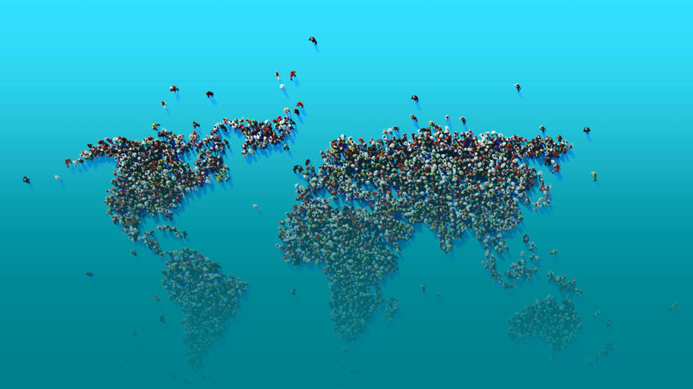
Behaviour Change for a Circular Economy How it works and why it pays off
Tuesday 29 March 2022
9am - 10am ET / 3pm - 4pm CET
MS Teams Link
Featuring behaviour change experts from

